Slide 1
Heckington Fen Solar Park
Summer 2023

Slide 2
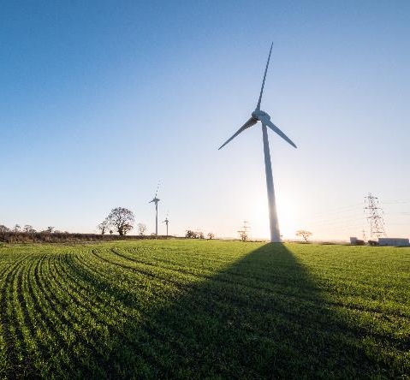
We’re Ecotricity,
Britain’s greenest
energy company
Ecotricity have been building new sources of green energy and supplying it to homes and business, across Britain - for over 25 years.
We pioneered the concept of green electricity and of decentralised supply.
We supply nearly 200,000 businesses and homes around Britain with 100% green electricity made from the wind
and the sun, and carbon neutralised gas.
We own and operate wind and solar parks across the UK.
Our Operations and Maintenance Team are based in Louth, Lincolnshire

Slide 3
Our vision for Heckington Fen
Our Solar Park could contribute towards the UK’s ambition to achieve net zero by:
Generating enough affordable green electricity to power over 100,000¹ homes – reducing our dependence on imported fossil fuels
Storing energy – providing additional flexibility to support the growth of renewable energy
Preventing more than 75,000 tonnes of harmful CO2 emissions per year
¹ See project website for more details - https://www.ecotricity.co.uk/our-green-energy/heckington-fen-solar-park

Slide 4
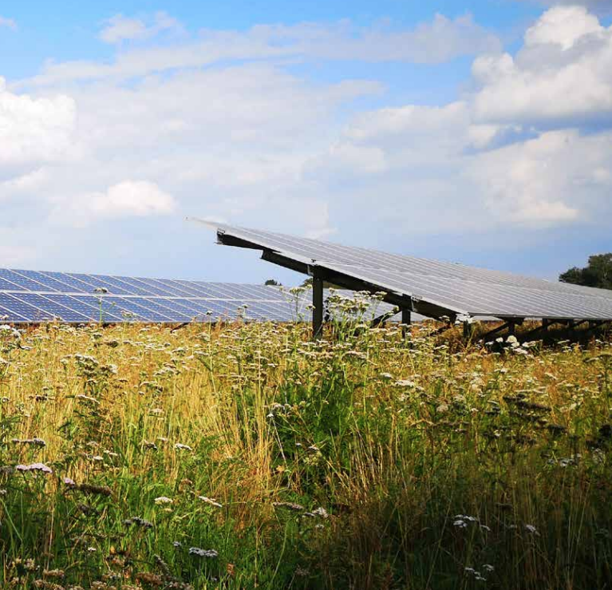
Our vision for Heckington Fen
Heckington Fen will support the local economy by:
Creating jobs and supply chain opportunities
Giving farmers an additional source of income, protecting the agricultural industry for future generations
Adding business rates of over £1m per year to North Kesteven District Council
The Project will enhance the local environment. We will:
Create additional wildlife habitat
Plant and manage new hedgerows
Reinforce boundary planting
Establish habitat corridors, helping wildlife thrive
Offer a new permissive path over 4km that links to the existing footpath in the area

Slide 5
Heckington Fen Solar Park
It is increasingly recognised that we are facing three key challenges linked to the natural environment:
The impacts of a changing climate
The impacts of declines in biodiversity, and
The increasing need to strengthen the connections between people and the natural world.

Slide 6
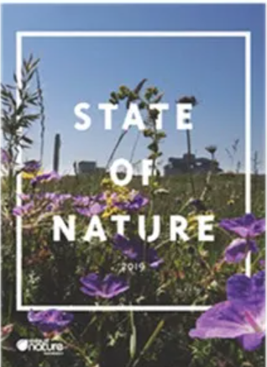
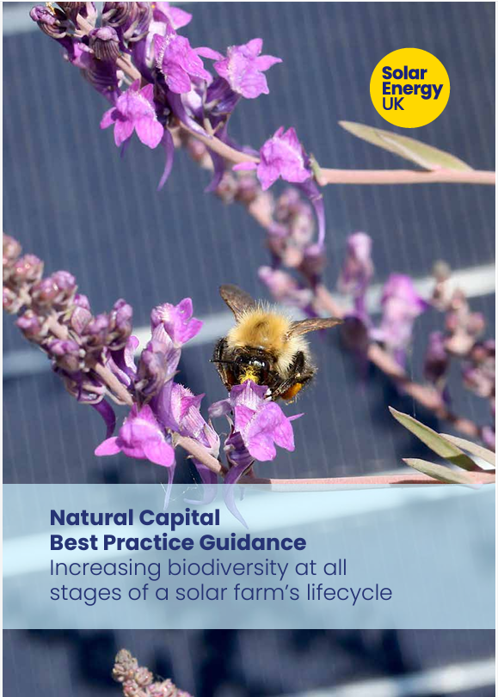
Heckington Fen Solar Park: Biodiversity
The UK’s State of Nature Report shows that the UK’s Biodiversity is declining at an alarming rate:
60% decline in biodiversity across the UK since the 1970s
15% of species in the UK are facing extinction
Declines are due to several factors including pesticide use and habitat loss
Well-designed and well-managed solar parks can help address these declines. Making “a significant contribution to both local and national biodiversity targets” whilst delivering clean, affordable energy. (Tony Juniper, Chair of Natural England)

Slide 7
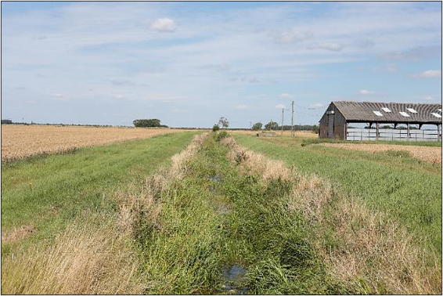
Ecological and Ornithological Assessments
Our surveys of the site sit within a wider suite of
assessments including:
Landscape and Visual
Residential Amenity
Hydrology, Hydrogeology, Flood Risk and Drainage
Cultural Heritage
Socio-economic
Noise and Vibration
Climate Change
Transport and Access
Air Quality
Land Use and Agriculture
Glint and Glare, and
Miscellaneous Issues
North-west of site looking North​

Slide 8
Heckington Fen Solar Park: Following the Mitigation Hierarchy
We’ve undertaken a combination of desktop studies and ecological surveys with the aim to identify the potential effects of the development on the nature conservation value of the site.
We’ve then looked to design the site to avoid these effects wherever possible. Where we’ve been unable to avoid these impacts, we’ve designed mitigation measures to limit our impacts.
Source: BSBI (2023) Little Book of BNG

Slide 9
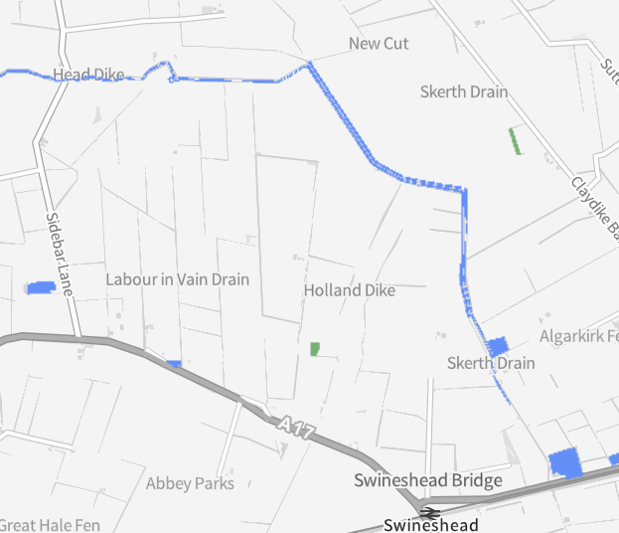
What We’ve Found: Designated Sites
The Energy Park
There are no designated sites of international, national or local importance within or adjacent to the Energy Park Site. There is one Local Wildlife Site, The South Forty Foot Drain, which will be crossed by the Off-Site Grid Connection.
The Wider Landscape
The Wash is the closest internationally important site situated approximately 16km to the East of the Energy Park (SAC/SPA/Ramsar).
Horbling Fen Site of Special Scientific Interest (SSSI) is located 11km from the energy park.
Source: DEFRA Magic.gov.uk

Slide 10
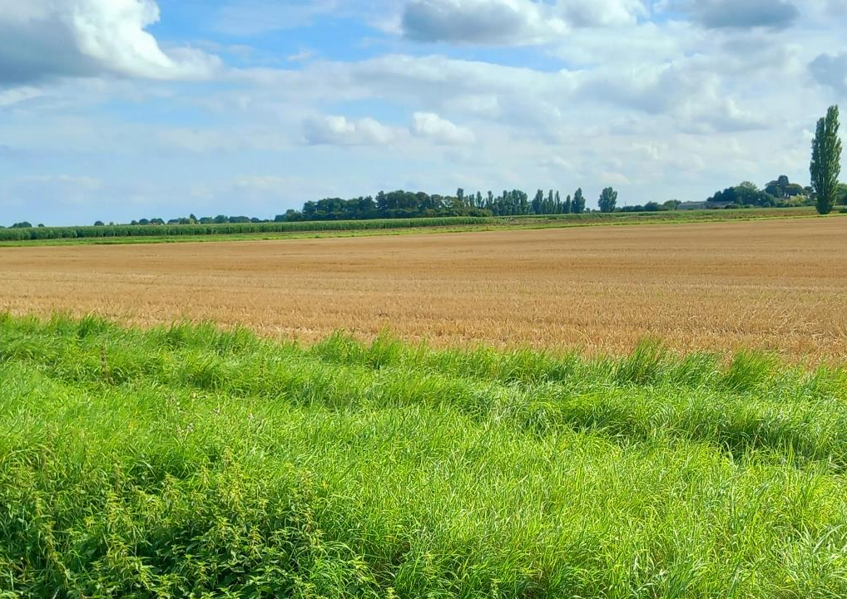
What We’ve Found: Habitats
Flat, low-lying farmland in continuous intensive arable wheat-production largely for animal feedstock.

Slide 11
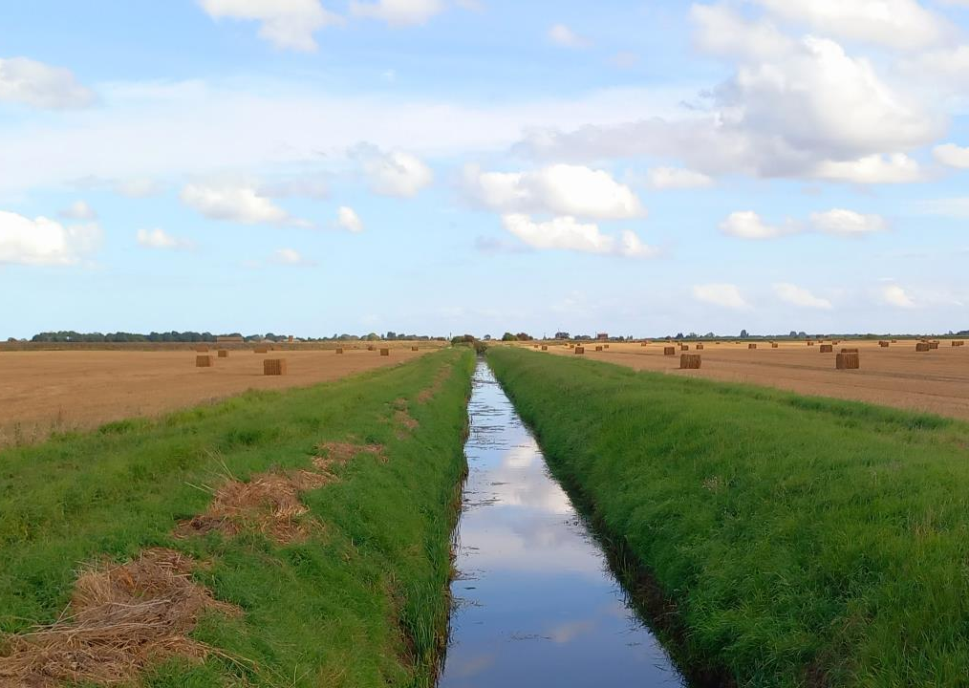
What We’ve Found: Habitats
Tracks, grass margins and drainage ditches.
The ditches having an engineered profile, some supporting occasional shrubs and trees, reeds and emergent aquatic vegetation.

Slide 12
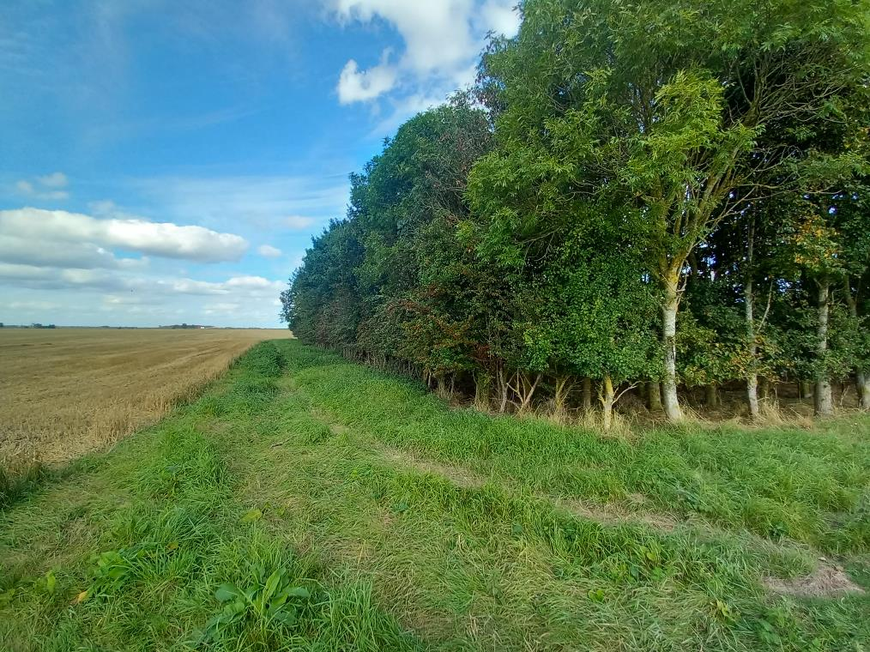
What We’ve Found: Habitats
Intermittent hedgerows forming boundary features.
Tree cover is limited to four small plantation woodland blocks and one line of trees within the centre of the Energy Park

Slide 13
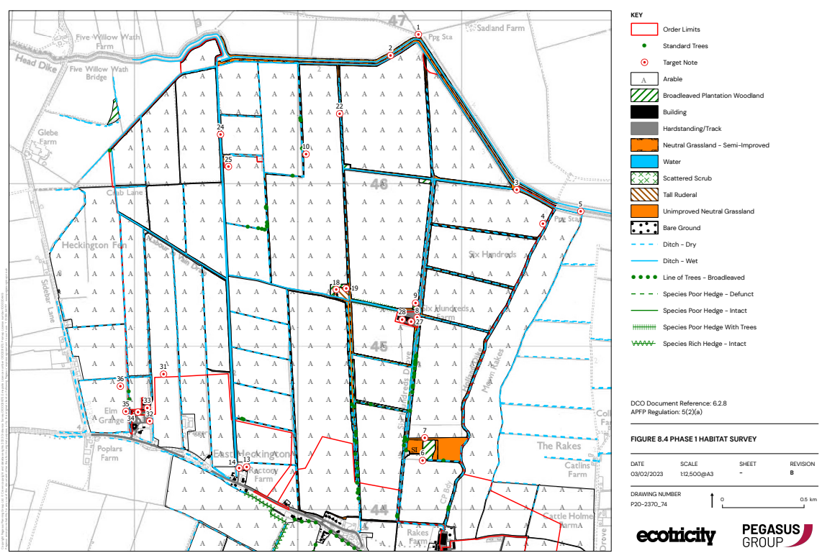
What We’ve Found: Phase 1 Habitat Map

Slide 14
What We’ve Found: Species
Amphibians and Mammals
Species surveys within the Energy Park site found no evidence of:
Great crested newt
Water vole, or
Otter
American mink, a major predator of water vole, was recorded as being present.
There was a low level of bat activity across the site focusing upon wet ditches and IDB managed drains.
Bats are known to be roosting in the centre of the Energy Park.
Badgers have recently colonised the area and two main setts are present on the Energy Park.
We are proposing to retain bat roosts and badger setts within the scheme.
There was no evidence of water vole or badger within the Grid Corridor Route. Otter was recorded on the South Forty Foot Drain.

Slide 15
What We’ve Found: Species
Breeding Birds
A total of 68 species were recorded during our breeding bird surveys.
We documented evidence of 56 species breeding. These included three Schedule 1 / Annex I species
Marsh harrier,
Barn owl, and
Kingfisher
This overall breeding bird community was typical of the wider Lincolnshire agricultural landscape, such that no species were found to be breeding in significant numbers.

Slide 16
What We’ve Found: Species
Wintering Birds
A total of 71 bird species were recorded on/around the Energy Park and grid connection route.
The numbers of birds involved were small and generally representative of insignificant proportions of highly mobile, much larger wintering populations present in the wider countryside.
The range and number of bird species found wintering on the Energy Park site are typical of the arable landscape within Lincolnshire and are assessed as being of local importance.

Slide 17
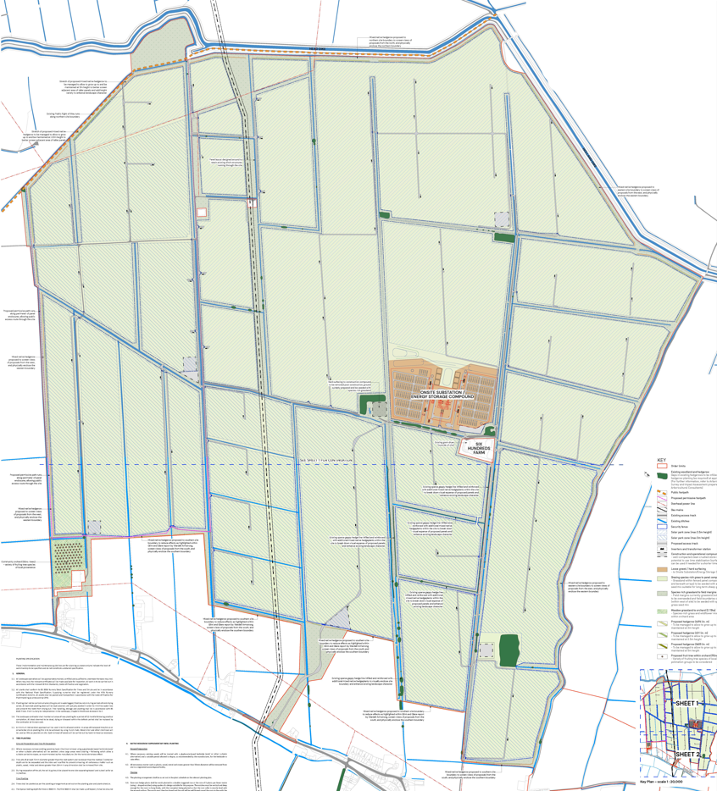
Heckington Fen Solar Park: Proposed Site Layout

Slide 18
Heckington Fen Solar Park: What the site might look like
Habitat Retention and Enhancement
We are proposing to retain all boundary habitats, woodland, ponds and wet ditches outside the area where the solar array, substations and energy storage facilities will be constructed.
Where we can we will look to enhance the retained habitats as much as possible.
Compensating habitat loss
The development will result in the loss of a small area of young plantation screening plantation at Bicker Fen Substation.
We will compensate for this loss by planting an area of woodland plantation in the North of the Energy Park

Slide 19
Heckington Fen Solar Park: What the site might look like
Arable reversion
The development will result in the conversion of approximately 440ha of intensive arable land to semi-improved grassland.
In addition, approximately 66ha of species rich grassland will be created in areas between our proposed security fencing and the drains & ditch network that we will be retaining.
Land-use under panels
We are intending to seasonally graze sheep between and within the solar panels. Stocking levels will reflect the wildlife conservation management objectives that will be set out in our management plan for the lifetime of the park.

Slide 20
Heckington Fen Solar Park: What the site might look like
Hedgerows
We are proposing to retain and enhance existing hedgerows and plant and additional 8.5km of new hedgerow around the Energy Park Site.
Community Orchard
We are proposing to create a 2.15ha community orchard. The orchards grassland will be maintained as a wildflower meadow.
Other Enhancements
We are proposing the installation of a variety of bird and bat boxes including a number of kestrel and barn owl boxes. These will be installed onto mature trees within the four woodland blocks and upon retained structures across the site.

Slide 21
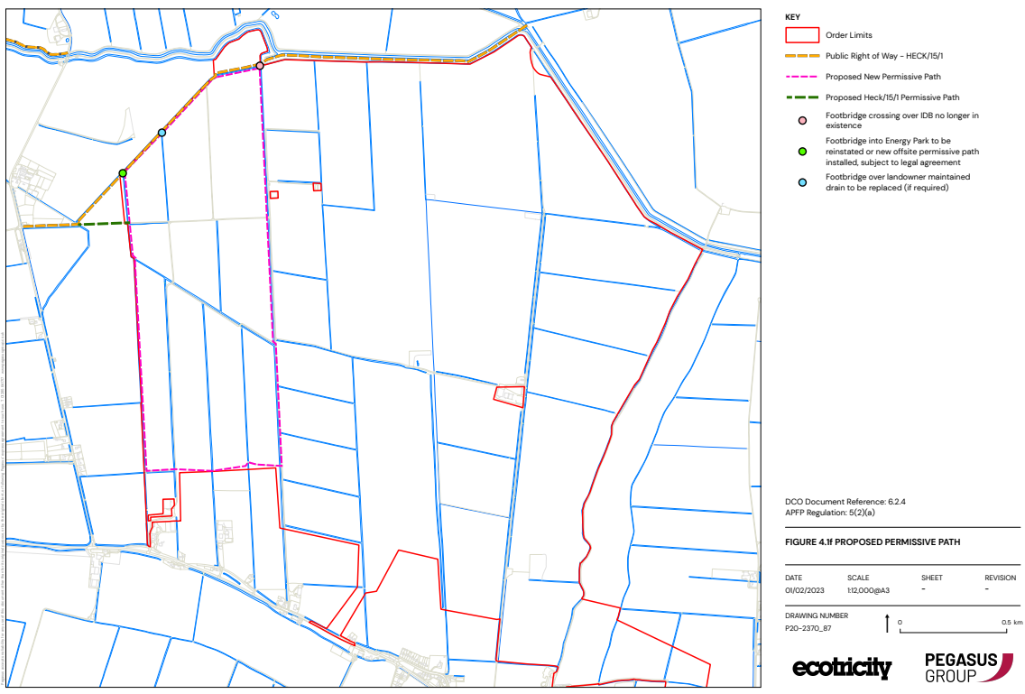
Heckington Fen Solar Park: Proposed permissive pathway

Slide 22
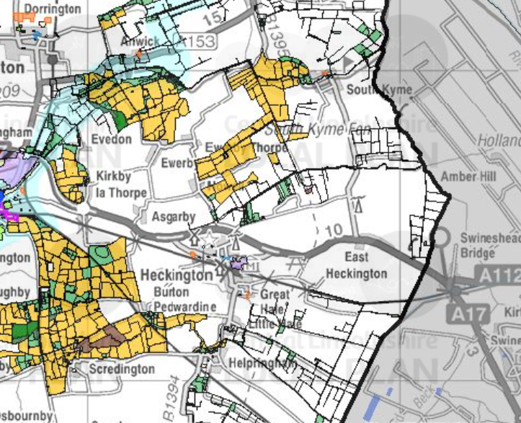
Heckington Fen Solar Park: Links to the wider landscape
Central Lincolnshire Biodiversity Opportunity Areas.
Links to Local Plan Policies.
Identifies areas key for habitat protection, enhancement and/or creation.
Development at Heckington Fen would introduce habitats of high nature conservation value in an area currently unmapped within the Opportunity Area framework.
Increasing landscape scale habitat connectivity. In line with the ‘Lawton Principles’ of a landscape where there are more sites for nature conservation that are bigger, better and more joined up.

Slide 23
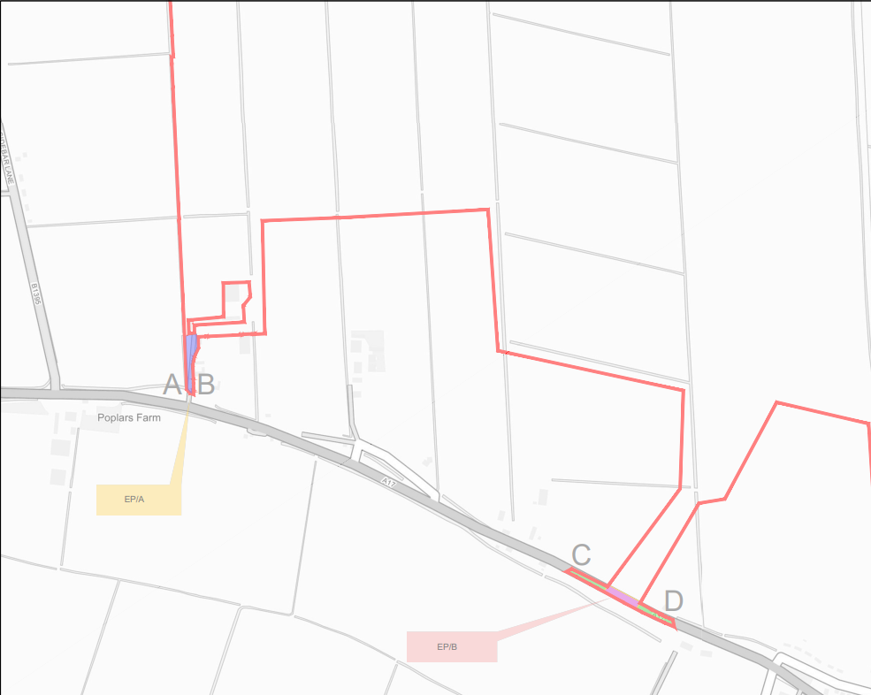
Heckington Fen Solar Park: Local road impacts and site access

Slide 24
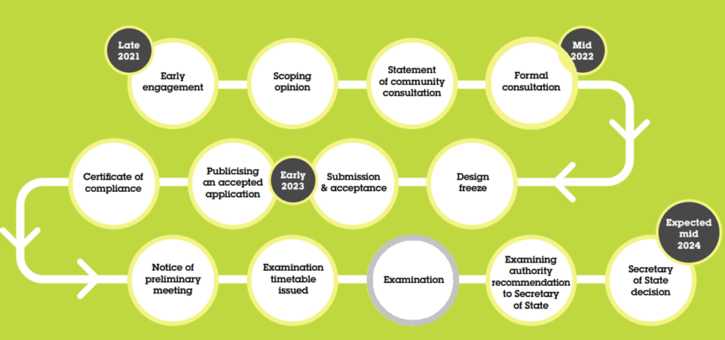
Next Steps: Planning timeline

Slide 25
Any questions?

